Slide 1
FAST CAMPUS NAVIGATION APP
Group 15
Group Members:
Abdullah Fayyaz 21L-5208
Owais 21L-5358
Syeda Aatika abid 21L-5455
Khizra Yaseen 21L-7517
Maryam Akbar 21L-5347
Suhaib Ahmad 21L-1805
Husnain Asghar 20L-0941

Slide 2
Overview
Image Collection & Dataset Preparation
Landmark Recognition Model
Distance Estimation & Dataset Labeling
Localization on Campus Map & Mobile App Development

Slide 3
Phase 1: Image Collection & Dataset Preparation
Image Collection
Total number of Images: 178
Block A: 15
Block B: 29
Block C: 17
Block D: 36
Block E: 28
Block F: 24
IEEE Office: 19
Camera Magnifications: 1x and 0.5x
Camera Used: 12 ProMax

Slide 4
Phase 1: Image Collection & Dataset Preparation
Dataset Preparation
Labeling: Roboflow
Dataset entries: Roboflow
Images resolution in dataset: 224*224
Image format: JPEG(jpg)
Issues Faced: Lighting , People

Slide 5
Phase 2: Landmark Recognition Model
Data Preprocessing
Augmentation is applied only to training set
Roboflow Augmentation
Python Augmentation (Rotate, Flip, zoom etc)
Total training images after Augmentation = 3754
In order to enhance the generalization of the model we did following using TensorFlow:
Resized all the images to 224x224
Normalized pixel values between [0, 1]

Slide 6
Phase 2: Landmark Recognition Model
Model Architecture
We used Xception Model with ImageNet weights
We added following Top layers:
- GlobalAveragePooling2D
- 256 Dense units with RELU
- Dropout= 0.5
- 7 output Dense units with Softmax
Training Parameters:
- Learning Rate= 0.0001
- Batch Size= 32
- Epochs= 20

Slide 7
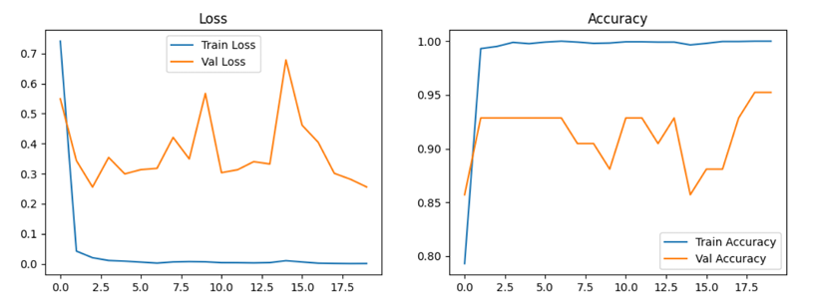
Phase 2: Landmark Recognition Model
Testing Results:
Test Loss: 0.3575
Test Accuracy: 0.9091
Test Precision: 0.9091
Test Recall: 0.9091
Test AUC: 0.9949

Slide 8
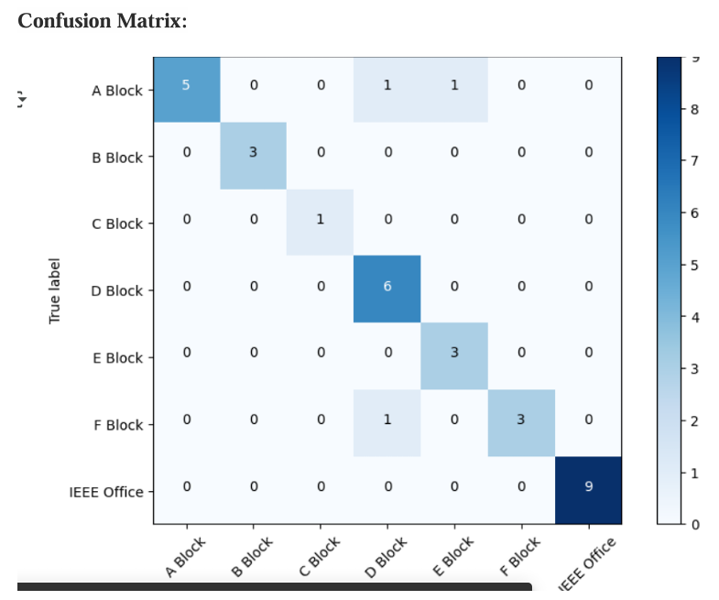
Phase 2: Landmark Recognition Model

Slide 9
Phase 3: Distance Estimation & Dataset Labeling
Measurement Phase
The first step was to take the measurement of the objects that would be consistently available in our images provided by the user.
This resulted in creation of 9 classes.
One was for door while the other were for windows of varying sizes.
These measurements were taken using a 5ft inch tape but due to sizes of New building estimation was used especially for the 800 class.

Slide 10
Phase 3: Distance Estimation & Dataset Labeling
Labelling Phase
Labelling done on roboflow
Challenge due to images at angle some images were smaller while other seemed smaller in images.
Extreme cases were not labelled.
Most windows if had a difference of size of 20 cm in that case the outline was more focussed on with/length.

Slide 11
Phase 3: Distance Estimation & Dataset Labeling
Model Training
After labelling as done yolo 8 model trained on 100 epoch
Distance calculation
We knew the camera used and also know what magnification the images were taken on thus we could calculate the distance using Focal Length (pixels)=(Sensor Height(mm)Focal Length(mm)​)×Image Height(pixels)
Thus with this we calculated the exact distance for that specific device.
To improve accuracy the distance to every object identified was measured and then average distance was calculated.

Slide 12
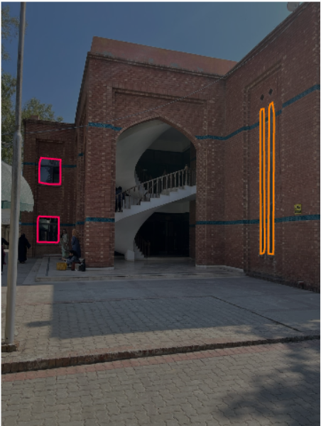
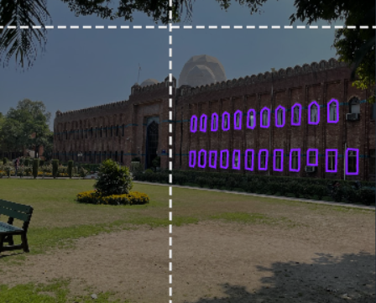
Labelled Dataset

Slide 13


Phase 4:Localization on Campus Map & Mobile App Development
Backend:
Developed Backend API using Flask in Python
Integrated trained Model with Backend
Frontend:
Developed Mobile App using React Native
Mobile App sends request to Backend Via Api
Api further using landmarks in model, predicts the distances

Slide 14
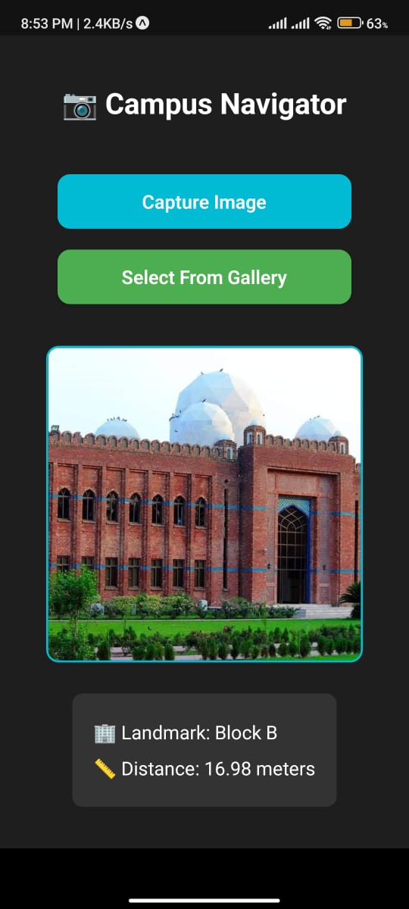
Results Achieved
This is the final result we get in our
“FAST Campus Navigation Mobile App”.

Slide 15
THANK YOU!

